Slide 1
lifeSAVER
- By Team-3 RAMPAGE

Slide 2
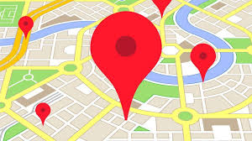
INTRODUCTION:
The Web Application is used to report to the nearest hospital or police station in case of any accident.
It also maintains a centralized database of location and casualities of the same.

Slide 3
Technologies Used:
1. PHP
2. JAVA SCRIPT
3. HTML
4. CSS
5. MY SQL

Slide 4
lifeSAVER
Accident can happen in any time ,any where so this ”lifeSAVER” is one which is useful for reducing deaths in accidents. This “lifeSaver”website work as when a person who see the accident first just have to enter location of the place ,the hospitals ,police station near the location is dispalyed and you just have to click the submit button of the hospital or police station .
it pop up the an alert message in respective hospital or police station website. so ,accordingly action is taken .
Drawbacks:
This is not an automatic message sending website , someone have to see the incident.this is main drawback of the project.

Slide 5
STEPS:
SEARCH BY LOCATION OR SUGGEST
REGISTER AND LOGIN
POPUP THIER WEBSITE
SEARCH HOSPITALS NEAR YOU

Slide 6
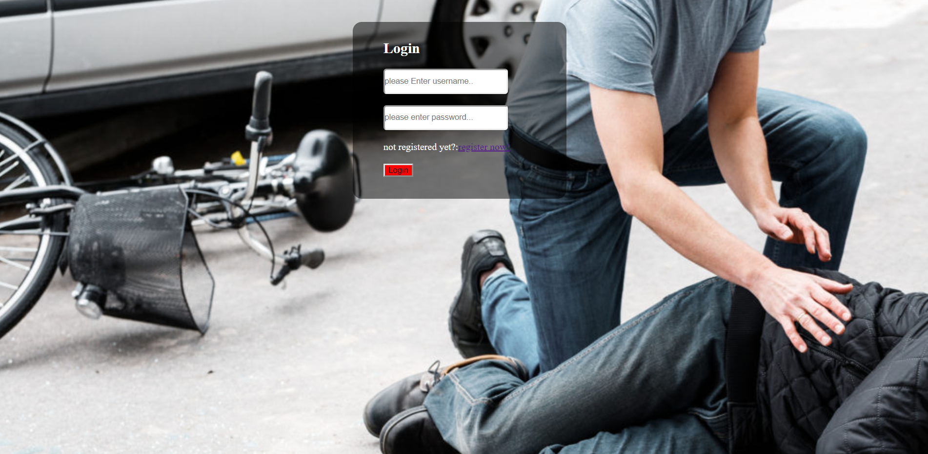
PAGE 1
If a user is already registered he can enter the credentials and login directly. Otherwise, the user needs to register by clicking “register now”.

Slide 7
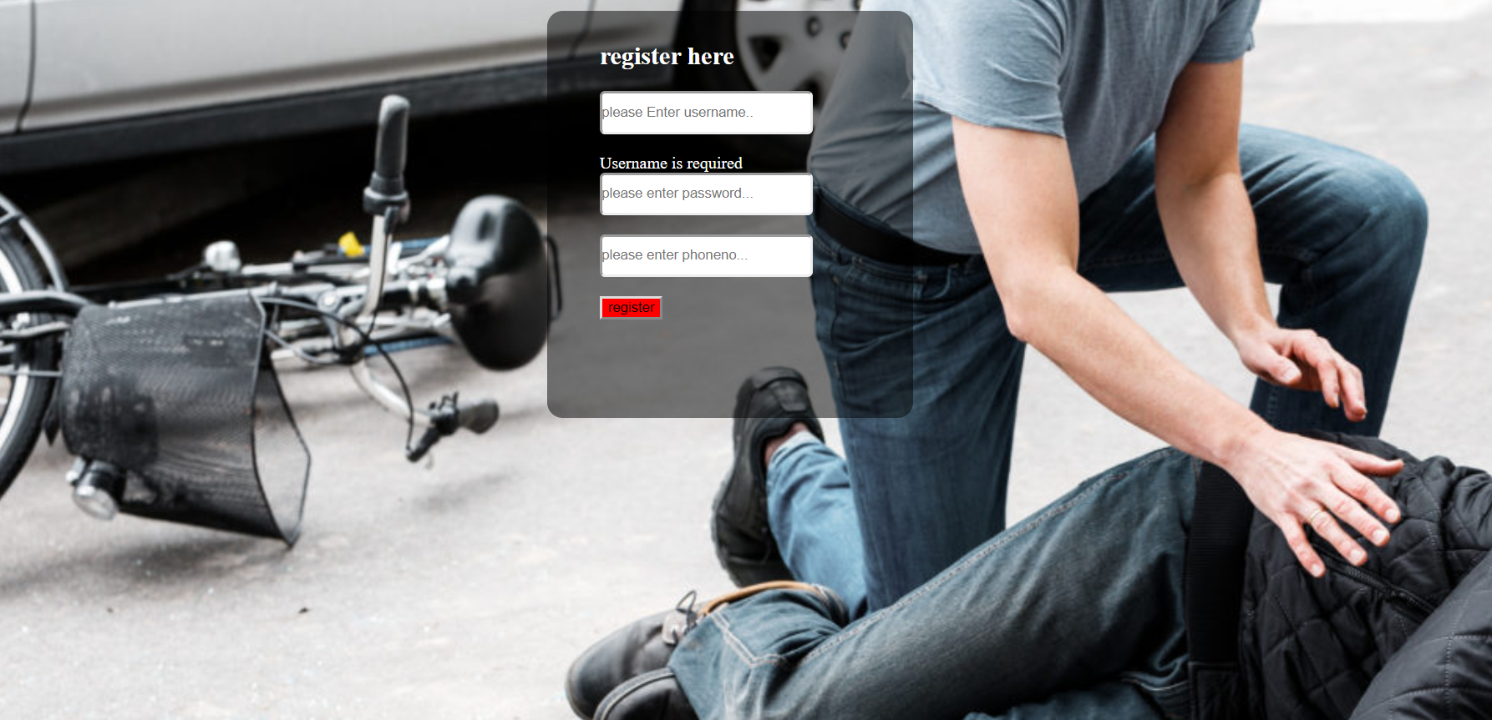
PAGE 2
The register page is displayed. After filling these details a new account is created and page 1 is displayed. The user must enter his credentials and now page 3 is displayed.

Slide 8
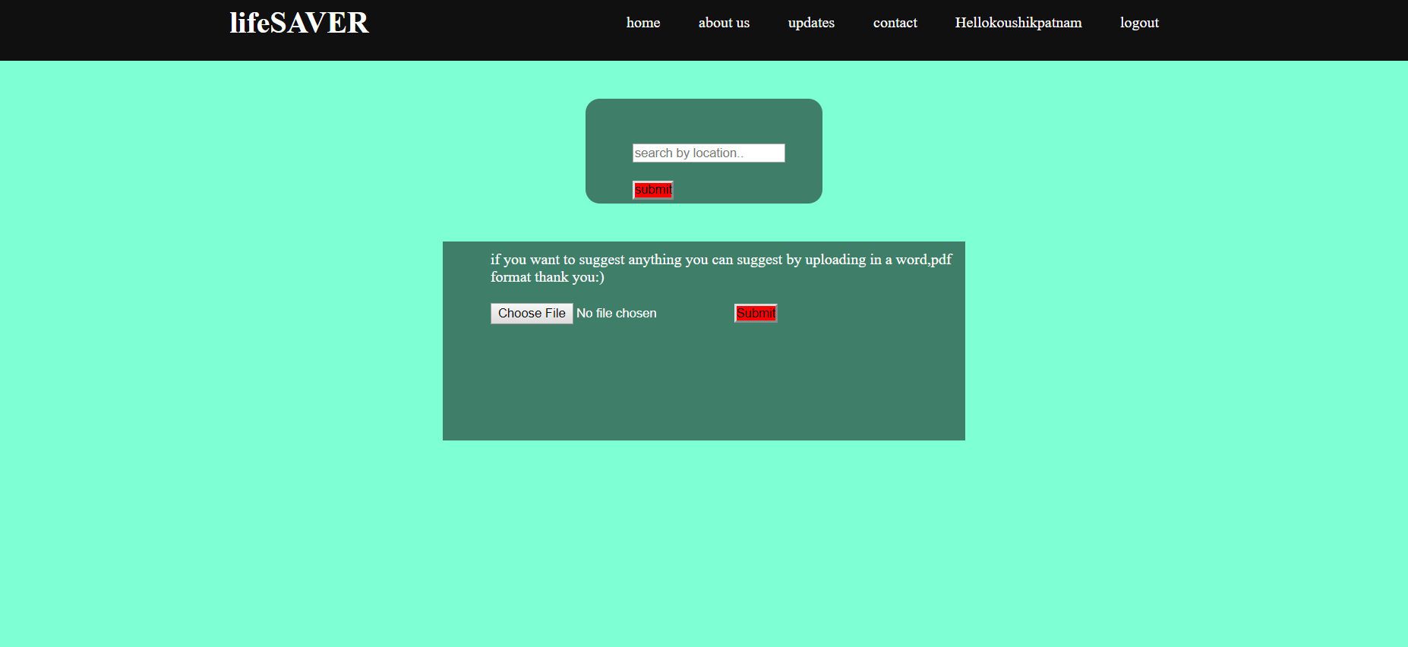
PAGE 3
Now, the users account is opened where he can enter the location of the accident and click submit to get nearby hospitals and police stations.

Slide 9
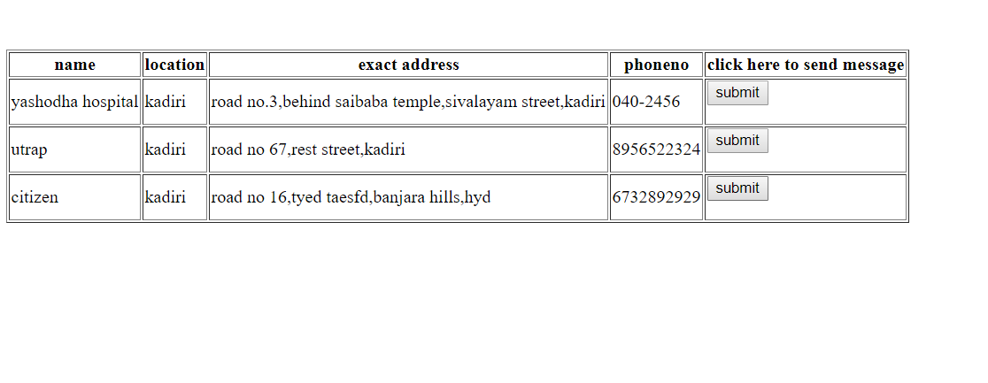
PAGE 4
The user should select any of the displayed hospital/police station.

Slide 10

PAGE 5
This notification is posted to the hospital website and the hospital can accept request by clicking ok.

Slide 11
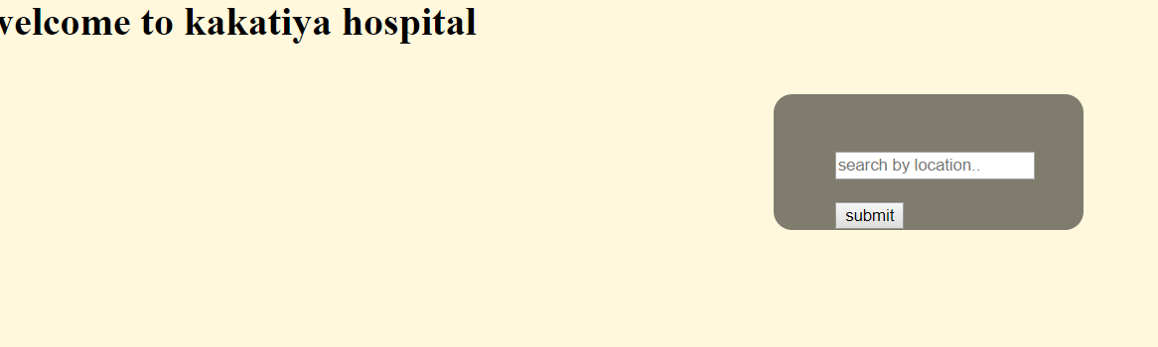
PAGE 6
This is the display of the actual hospital website where they can also access the number of previous request's records by the user name.

Slide 12

CONCLUSION
Since all the data is collected, the most accident prone areas can be found out and can help to prevent furthur accidents.

Slide 13
THANK YOU!

